Slide 1

SplitShit
Notes:
I called my program splitshit, because it splits shit. With shit being money.
Also the only reason you would use this program is as a joke because it is so shit.

Slide 2
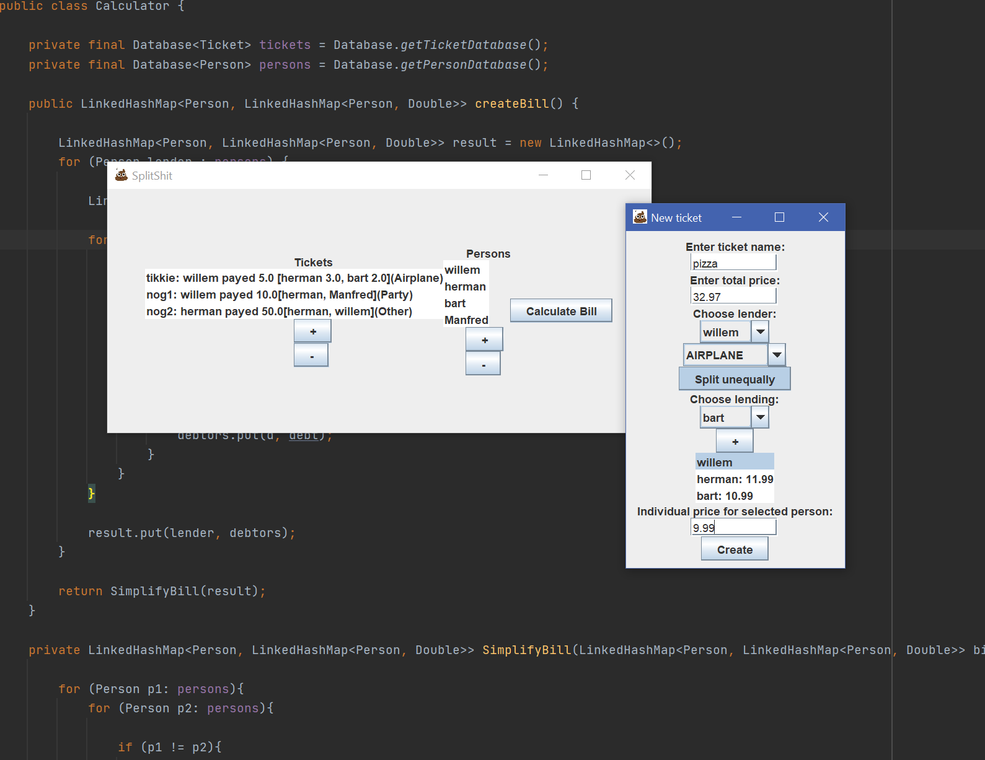
Notes:
Let’s first have a look at the UI

Slide 3
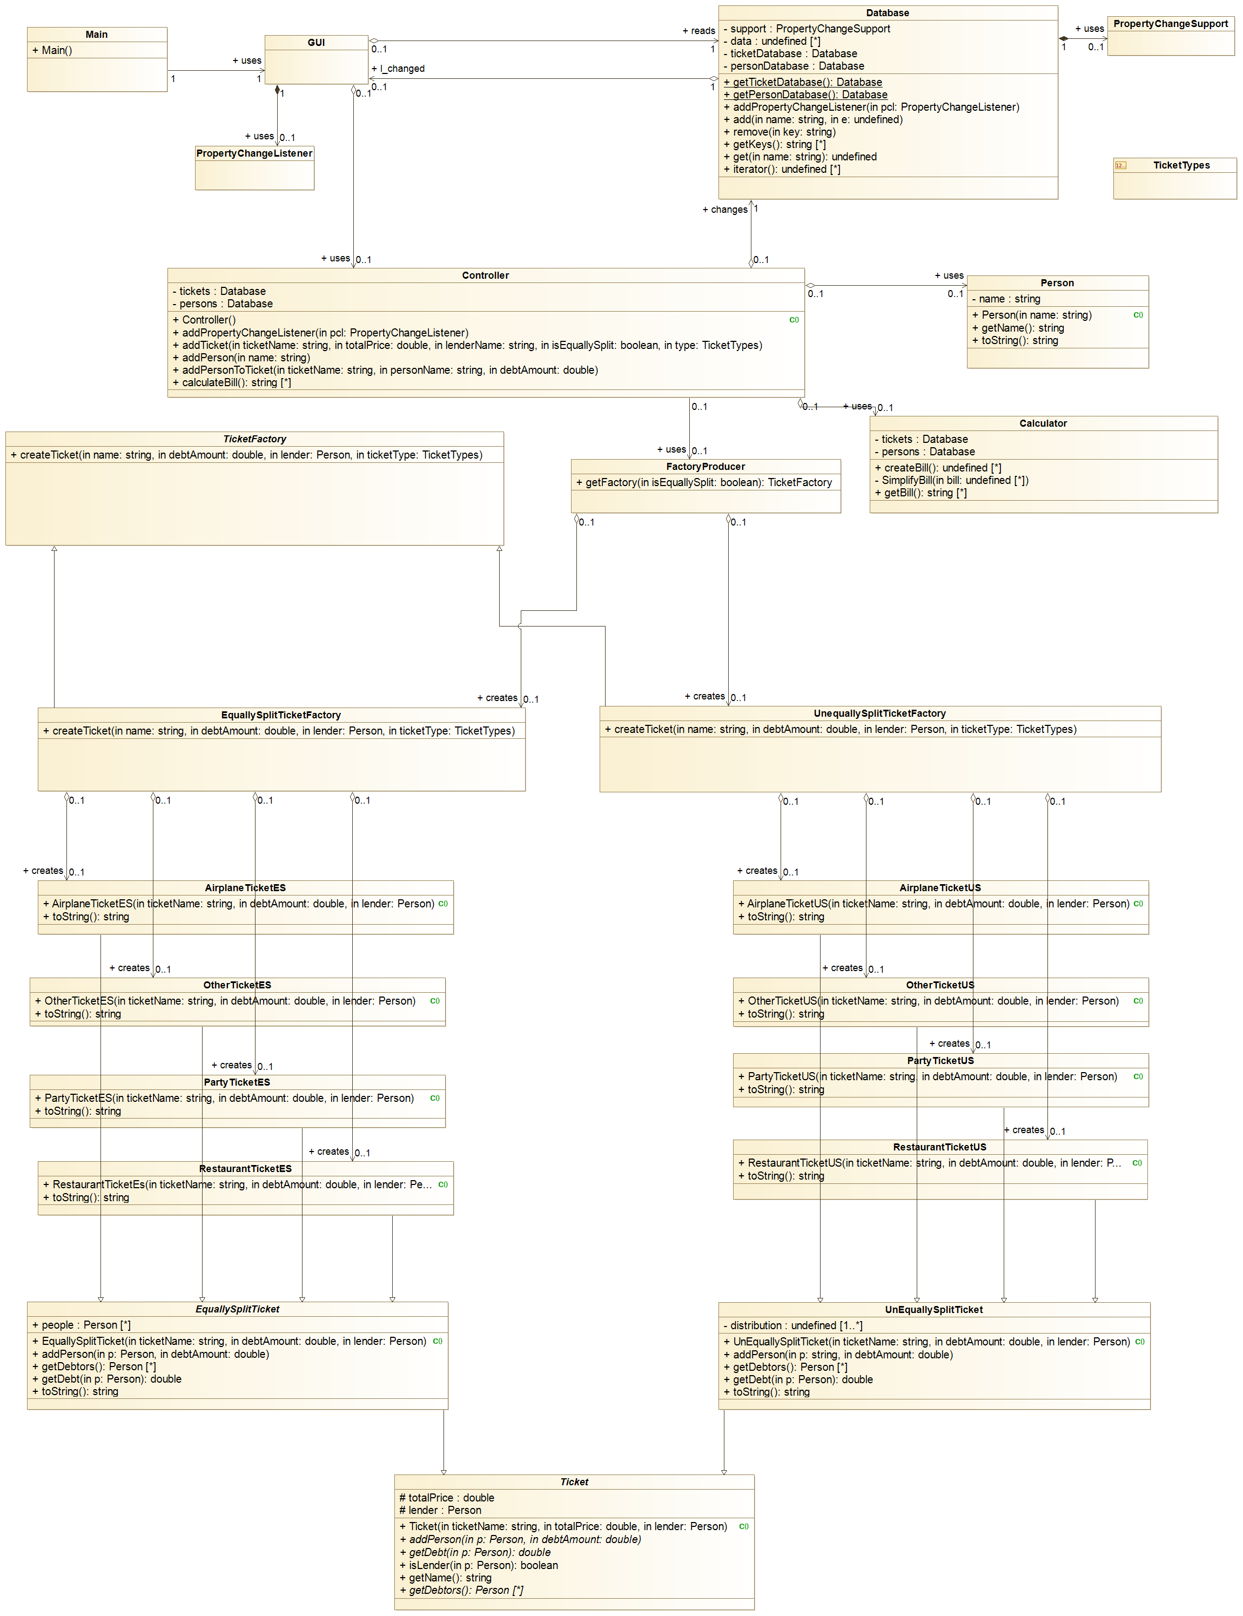
Class Diagram

Slide 4
Notes:
We can see the database here with 2 singletons that contain the tickets and persons. The propertyChangeListener/Support is my alternative for the Observer Pattern because the normal observer patern is deprecated.
The factoryProducer creates the correct factory for equallySplit and unequallysplit factories. These bottom factories are inherit from the abstract factory ‘TicketFactory’.

Slide 5
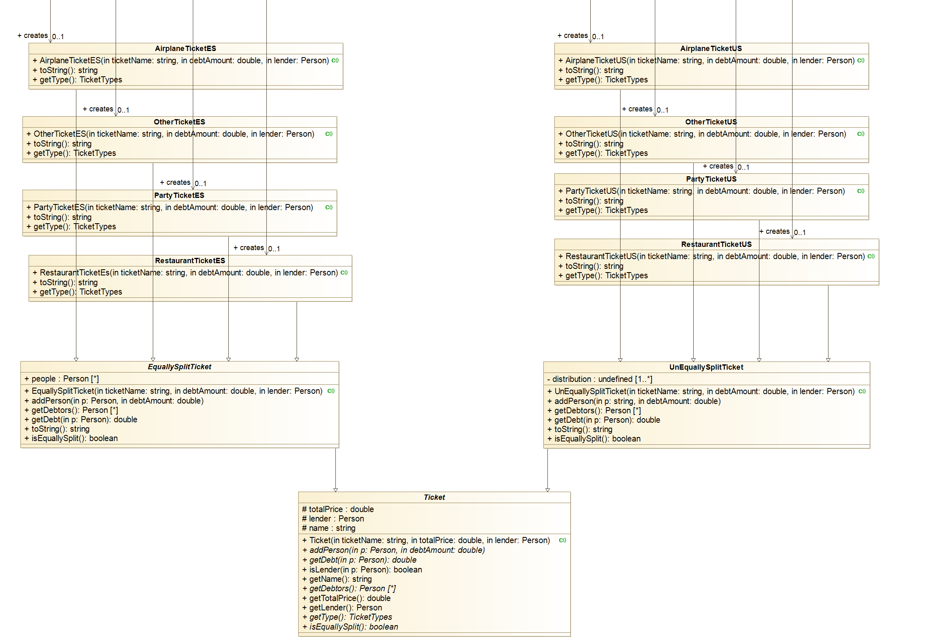
Notes:
All the different types of tickets are designed with inheritance. The top 8 just have a different name, but could easily get other functionality depending on their type.

Slide 6
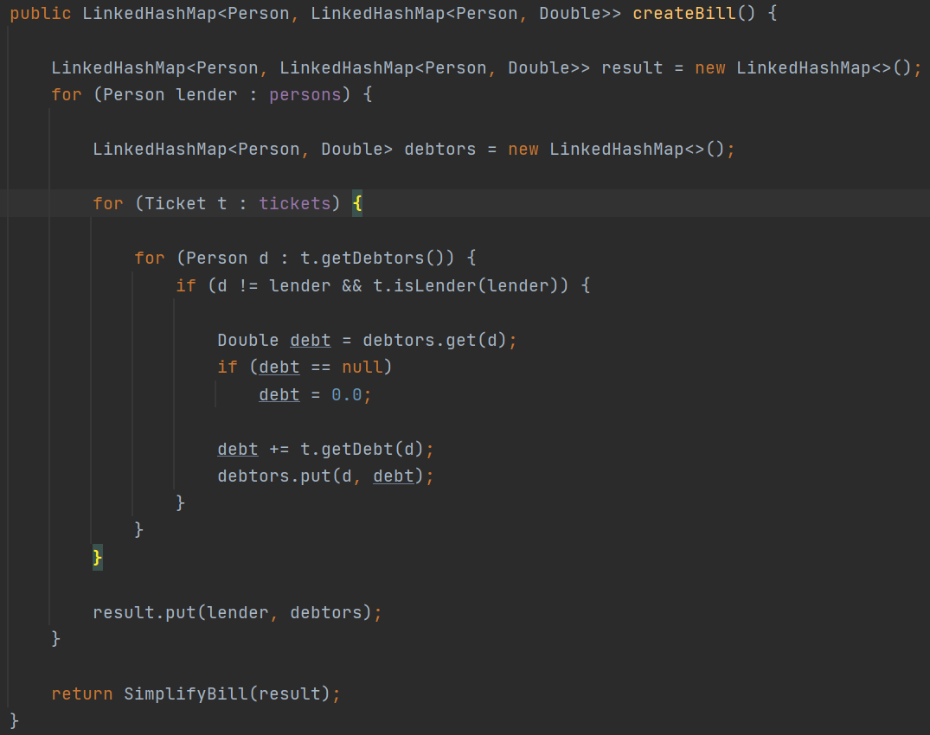
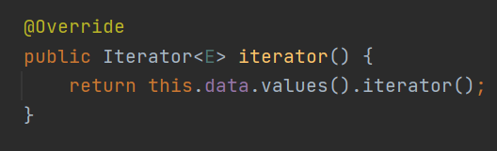
Special patern
Iterator
Database:
Notes:
Iterator in database. I just steal the already existing one for a HashMap
I need it to iterate over all tickets and persons when calculating the bill in the class: Calculator
The controller kinda acted as a façade.

Slide 7
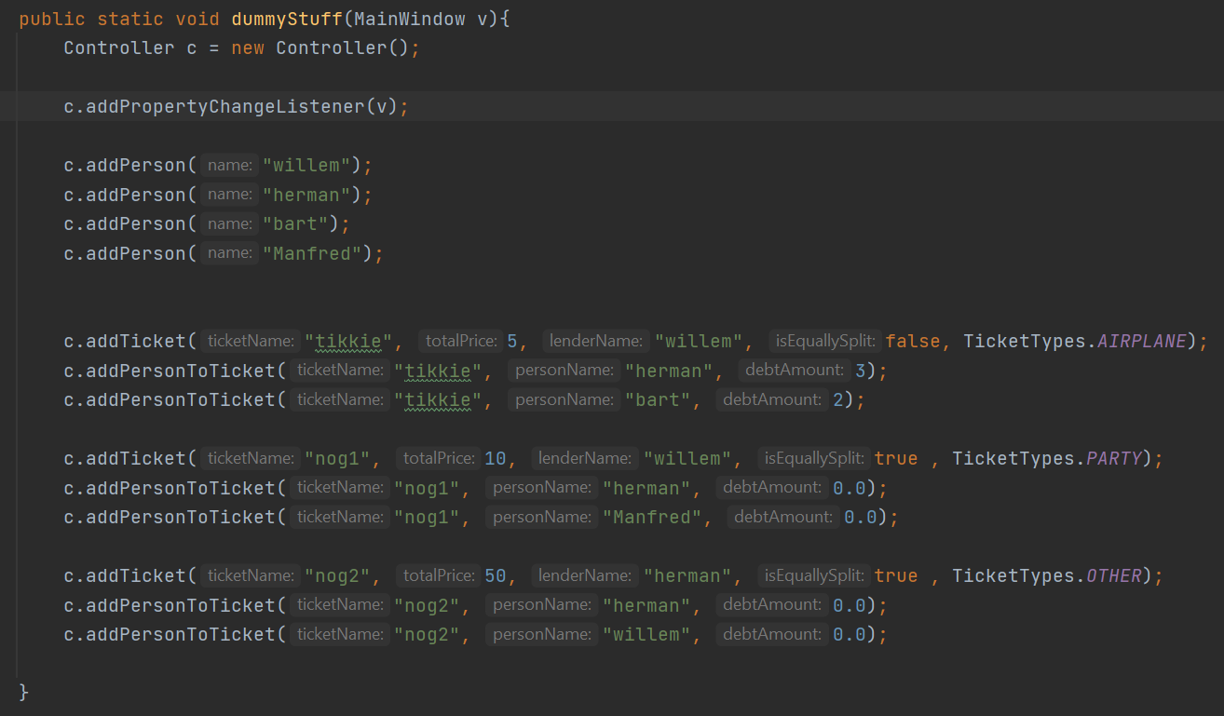
Special patern
Iterator
Controller ≈ Façade
Notes:
Iterator in database. I just steal the already existing one for a HashMap
I need it to iterate over all tickets and persons when calculating the bill in the class: Calculator
The controller kinda acted as a façade.

Slide 8
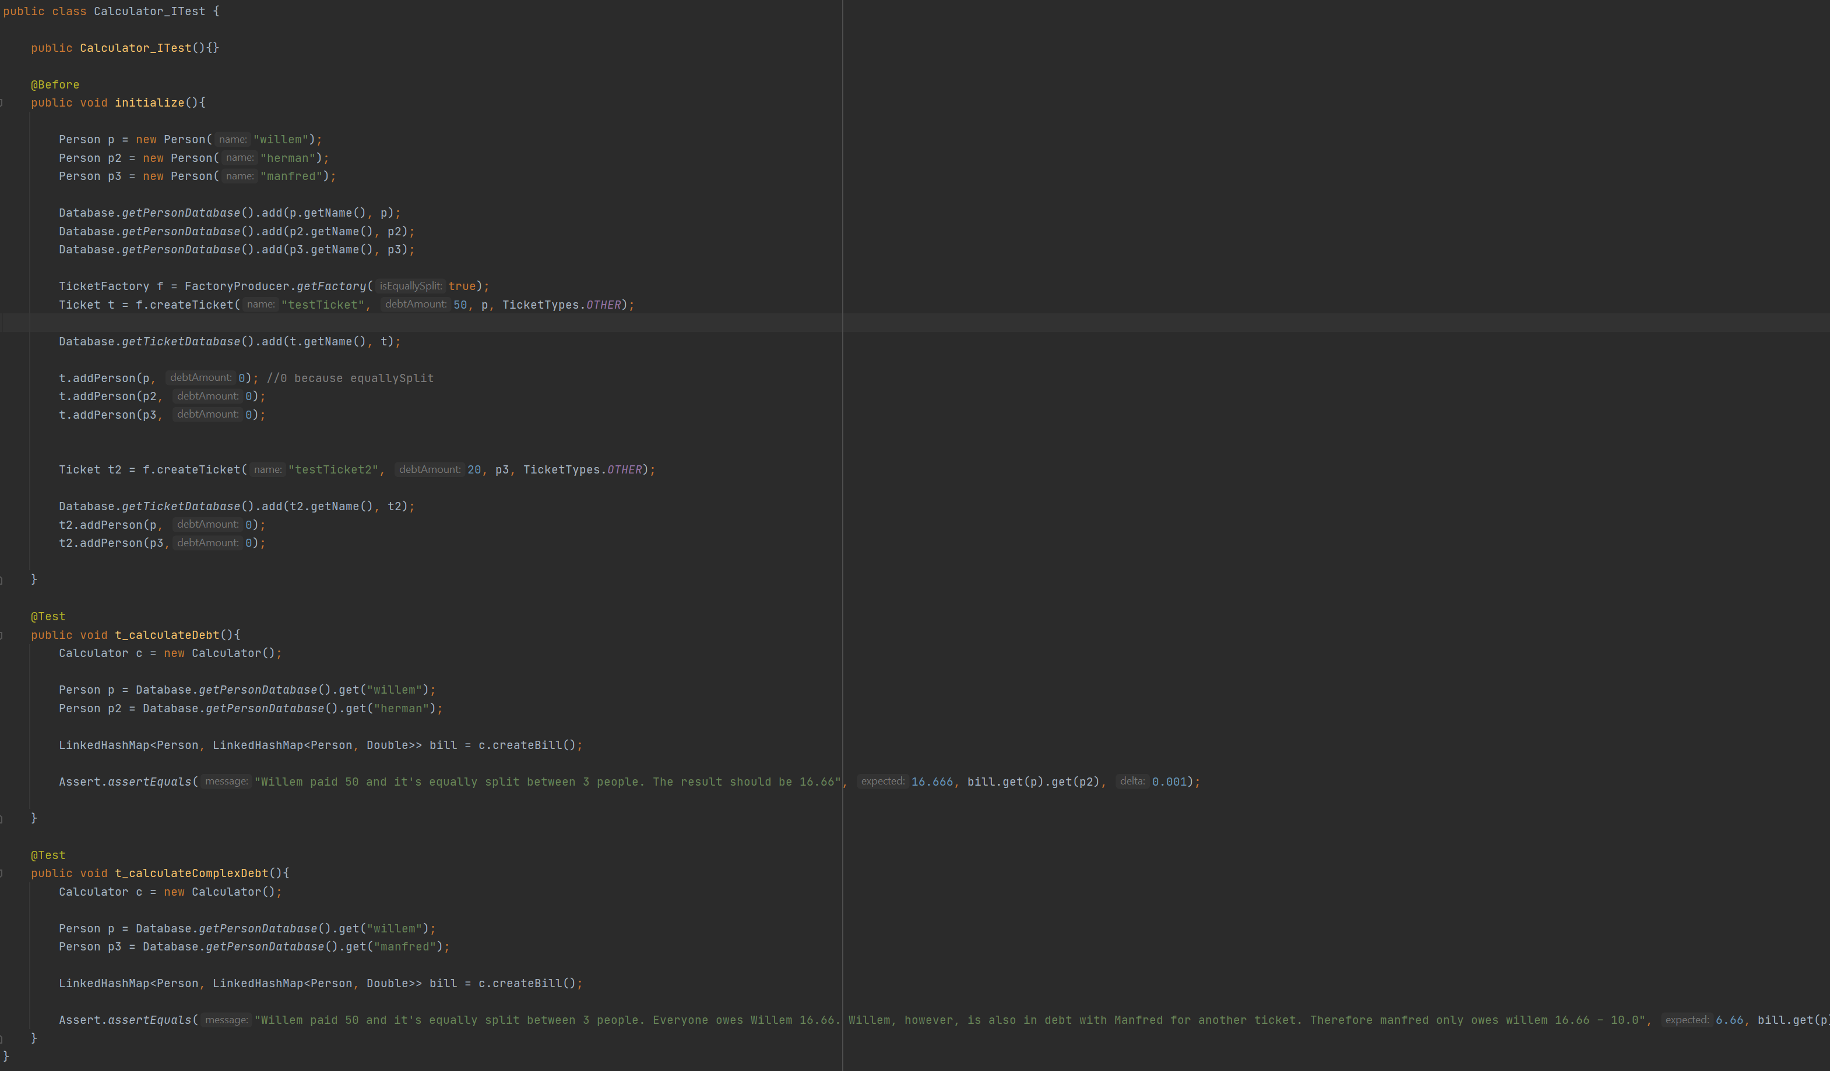
Test
“Willem paid 50 and it's equally split between 3 people. Everyone owes Willem 16.66. Willem, however, is also in debt with Manfred for another ticket. Therefore manfred only owes willem 16.66 - 10.0”
Notes:
This Integration test came in helpfull when creating the improved bill calculation which summarizes the debt between 2 people.

